Slide 1

G.A.I.A.:
Ground Assessment and Identification Assistant
An AI-powered pothole detection system that uses computer vision and machine learning to automatically identify and map road hazards, enabling faster repairs and safer driving.

Slide 2
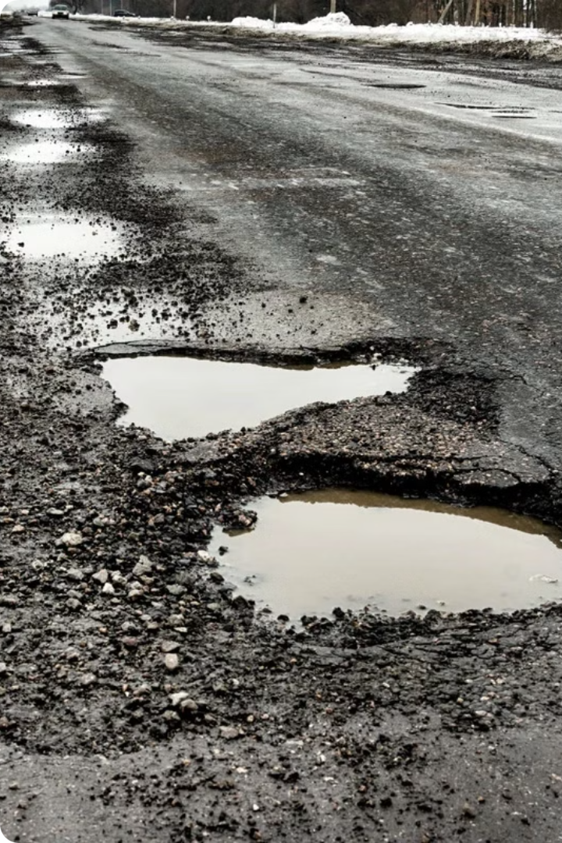
The Pothole Problem
Potholes are a widespread and persistent issue, costing billions in vehicle damage and leading to countless accidents each year. Current detection and repair processes are slow and reactive, often leaving roads in disrepair for extended periods.
Addressing this problem requires innovative solutions to proactively identify and address potholes before they become a hazard to drivers and pedestrians.

Slide 3
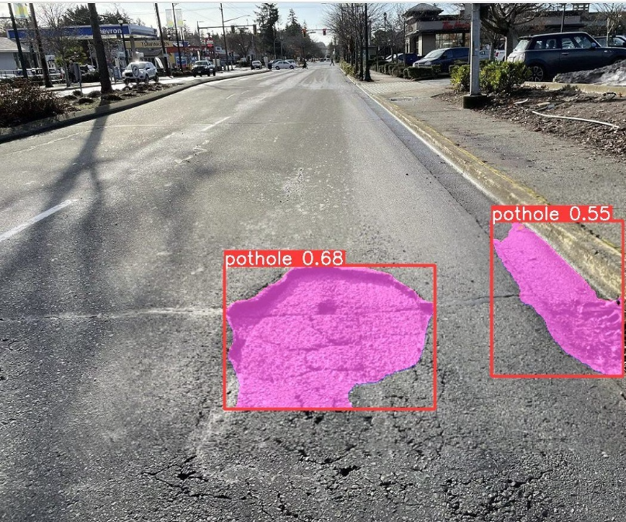
Introducing G.A.I.A
G.A.I.A, or the Ground Assessment and Identification Assistant, is an innovative AI-powered platform designed to detect and map potholes on roads. By leveraging advanced computer vision and machine learning algorithms, G.A.I.A can automatically identify potholes from images captured by drones or vehicle-mounted cameras, providing detailed reports to help cities and municipalities prioritize road maintenance.

Slide 4
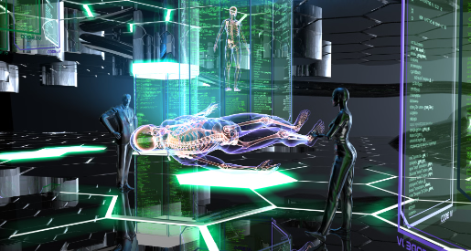


Key Features of G.A.I.A
AI-Powered Detection
Data Analytics
Scalability
G.A.I.A utilizes advanced computer vision and machine learning algorithms to accurately identify potholes in real-time, even in challenging lighting or weather conditions.
The system generates detailed reports on pothole locations, severity, and trends, providing actionable insights to guide infrastructure maintenance and repair efforts.
G.A.I.A is designed to be adaptable to a wide range of environments and infrastructure setups, making it a versatile solution for cities and municipalities of all sizes.

Slide 5

Technology Behind G.A.I.A
Object Detection Model
Cloud Processing
Security & Reliability
G.A.I.A. leverages advanced object detection algorithms to accurately identify and classify potholes, cracks, and other road defects from overhead imagery.
Captured data is securely transmitted to the cloud for high-speed analytics, leveraging distributed computing power to generate insights in real-time.
Robust security measures and redundant systems ensure the privacy and integrity of user data, delivering a reliable and trustworthy solution.

Slide 6

Market Opportunity
G.A.I.A. has immense potential in the rapidly growing smart infrastructure market, targeting municipalities, transportation agencies, and road maintenance companies seeking advanced AI solutions to optimize infrastructure management.
Compared to other infrastructure monitoring solutions, G.A.I.A. stands out with its unparalleled accuracy, efficiency, and cost-effectiveness. Our proprietary computer vision algorithms and sensor fusion technology allow us to detect and classify infrastructure defects with industry-leading precision, far surpassing manual inspections or basic image recognition tools.

Slide 7
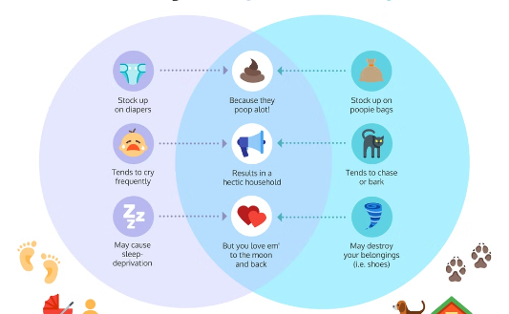

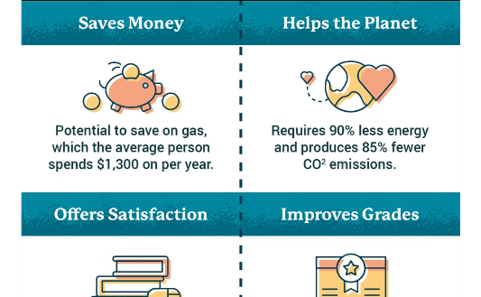
Competitive Analysis
Comparison
Unique Strengths
Advantages
G.A.I.A stands out from existing pothole detection and infrastructure management solutions with its advanced AI-powered computer vision capabilities and comprehensive data analysis.
The system's ability to accurately identify pothole severity, prioritize repairs, and integrate seamlessly with municipal infrastructure sets G.A.I.A apart in the market.
G.A.I.A offers cities a cost-effective, scalable solution to proactively manage road infrastructure, reducing maintenance costs and improving driver safety.

Slide 8

Business Model
Revenue Streams
Pricing Strategy
Monetization Opportunities
G.A.I.A. will generate revenue through product sales, subscription services, and data analytics services to help cities and departments identify and address infrastructure issues.
G.A.I.A. will use a tiered pricing model, offering a basic free version and premium subscriptions with advanced features and support. Pricing will be competitive and aligned with the value delivered.
By leveraging the rich data collected, G.A.I.A. can also provide valuable analytics and insights to generate additional revenue streams through data-driven services.

Slide 9

Roadmap
1
Short-Term Goals
Launch G.A.I.A in 3 major cities, onboard 5,000 users, and continually improve the app based on user feedback.
2
Medium-Term Expansion
Expand to 10 additional cities, grow the user base to 50,000, and develop new features like pothole prediction and automated reporting.
3
Long-Term Vision
Become the industry-leading ground assessment and identification assistant, serving over 1 million users across the country.

Slide 10

Conclusion
G.A.I.A. has the potential to revolutionize ground assessment and identification, offering a comprehensive and efficient solution to the persistent problem of potholes and road infrastructure issues. By leveraging cutting-edge technology, G.A.I.A. can provide accurate data and insights to help municipalities prioritize repair efforts and optimally allocate resources.

Slide 11
No. | Title | Cost | Description
1 | Compute instance | ₹ 15,000.00 | Renting a server to train the ML Model on cloud resources
2 | AI Development | ₹ 15,000.00 | Development of ML Model for our device
3 | Raspberry Pi Camera | ₹ 2,500.00 | Camera Module which will be the input device for the images.
4 | Google Coral Accelerator | ₹ 13,000.00 | Edge TPU co-processor, enabling high-speed machine learning inferencing on a wide range of systems
5 | Raspberry Pi Display | ₹ 5,000.00 | Display to view the results of live inferencing
6 | Raspberry Pi 5 | ₹ 9,000.00 | Single Board Micro computer controlling the entire device
7 | Raspberry Pi Zero 2 W | ₹ 2,500.00 | Single Board Micro computer controlling the entire device
8 | Casing Design | ₹ 10,000.00 | Design the casing for the device
9 | Casing | ₹ 10,000.00 | The casing which will contain our device
10 | Battery | ₹ 5,000.00 | Battery to run the device
 | Total | ₹ 87,000.00

